Slide 1
Creating a Training Culture Multiply Conference Ann St Presbyterian Church, Brisbane, QLD 17th May 2016.
Notes:
It is a joy to be here with you today.
I am hoping that today’s session will be interactive.
Feel free to make comments, ask questions, etc along the way.
I will break it up a bit some activities along the way.
Let me pray.

Slide 2
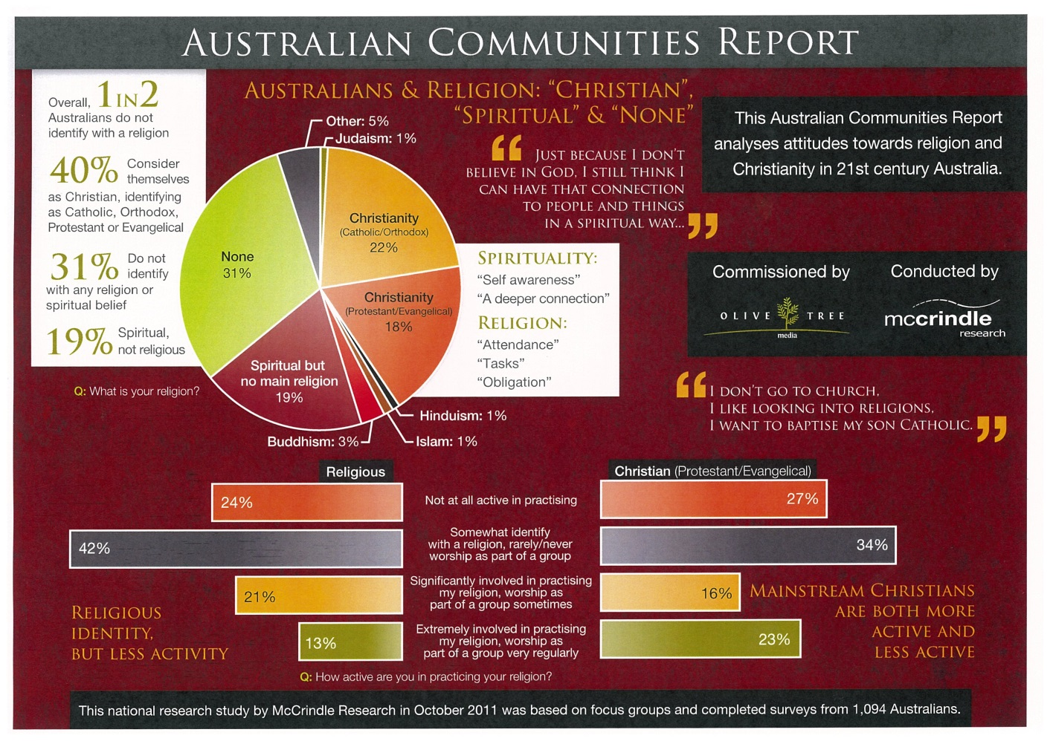
The State of Play: Australia
Notes:
1 in 2 Australians do not identify with a religion – not the Christian religion – ANY religion.
Think of one person you’ve seen come to Christ in the last few years.
What difficulties did they face when they turned to Jesus? (Money, Sex, Power)
Richard Shumack uses to illustartion of a Muslim turning to Jesus = AFL member to becoming a NRL card carrier. (“He has betrayed his own).
11.5 million need to be
introduced to Jesus
Grown in Jesus
Established
Taught to create other subversives.
God’s agent in the world to do his work is the Church.
What is the current state of paly in the Church?

Slide 3
The State of Play: The Church
Notes:
18% Protestant Evangelical (1/5)
23% “worship very regularly” (1/5)
Question: what % of your “regular church attenders” are disciple making disciples? 20%? (1/5)
If that were the case – then we have 1 x DMD for every 125 Australians.

Slide 4
The State of Play: The Church
Quantity
McCrindle – 1 x DMD / 125 Aussies
The number of 15 year olds leaving the church has increased from 10% to 35% in the last 10 years
Anglican Diocese of Sydney (2002-2012) grew 0.5%

Slide 5
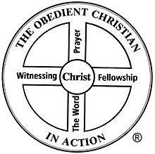
The State of Play: The Church
Quality
Notes:
I have surveyed Year 13 students at Youthworks College Woronora for the last 4 years.
These are people who finished the HSC (Year 12) the previous year and they are from evangelical and reformed evangelical Churches across NSW (& QLD)
Typically there are 70-90 students each year.
I teach them about “The Navigators Wheel” on the Board.
How the Navigator Movement used this diagram over decades to train people.
Every year I teach them about it and then ask them to think about the Church community/Christian tribe that you come from.
I then ask two questions:
What is your church/tribe strongest in?
What is your Church/tribe weakest in?
What do you think they say? Chat with the person next to you and tell them what you reckon the results would be.
Answer:
Strongest in “The Word”
Weakest in “Witnessing”
There is much to be thankful for obviously.
But there is much to be concerned about.

Slide 6
The State of Play: Summary
We are not reaching everyday Australians with the Gospel
Why? We have a training culture problem in the Church
Why? Partly because we have a training culture problem in our society
Notes:
What do I mean when I say, we have a training culture problem in our society.
Well, I trained to be a Civil Engineer at RMIT University in 1988.
I had no construction background, my father didn’t even have an operational tool box in the garage.
So how did society deem it appropriate for me to train as a Gingerbeer?
They said, “You need to sit in a classroom for 4 years an complete academic qualifications”
Did I go on site for some assignments? Yes. But I didn’t do anything for those assignment other than observe, analyze and critique.
It was an interesting 4 years, because from the middle of Year 2 to the middle of Year 4 a massive sky scraper (Melbourne Central) was being built, we could see it out the class window 100 metres away. It slowly grew up and up. And in our class for that same period of time was Neil. Neil was a 40 year old guy who was a member of the structural Engineering Company that designed and was building Melbourne Central. Neil was in our class. Neil started with the company 20 year prior and learned structural engineering on the job. Problems were starting to arise that Neil was designing building, like Melbourne Central, but he didn’t have the appropriate qualifications to be able to keep doing it. He had to go, as a mature age student, and “get his bit of paper”.
This bloke was in our class. It was awesome hearing him talk all about it.
In 4th Year, the lecturers got us together for a feedback session on the course.
There were about 30 x 4th years in a room (including Neil).
The lecturers asked, what do you think the strengths and weaknesses of the course are? We want your honest feedback.
People my age talked about spreading assignments out during the term etc.
Then Neil says, “Did you want honest evaluation?” They said, “Yes, of course”.
Neil said, “This course is the biggest load of bulldust I have ever had to endure in my life. It doesn’t prepare people for Civil Engineering. Most of the people in this room do not even know what a purlin is?” (To which I said, “What is a purlin” and everyone had a laugh. I genuinely didn’t know that a Purlin was a basic, basic roofing bracket.
That’s what our world does.
The culture of any society will inevitably affect the culture of the church in that society.
The training culture of our society affects the training culture of the church.
Now you might be asking the question, “This discussion about the state of play is discouraging. Should we all just give up now?”
My answer to you is: “Don’t be discouraged, and No, don’t give up”.
My advice is: “Stay Calm and Trust Jesus”

Slide 7
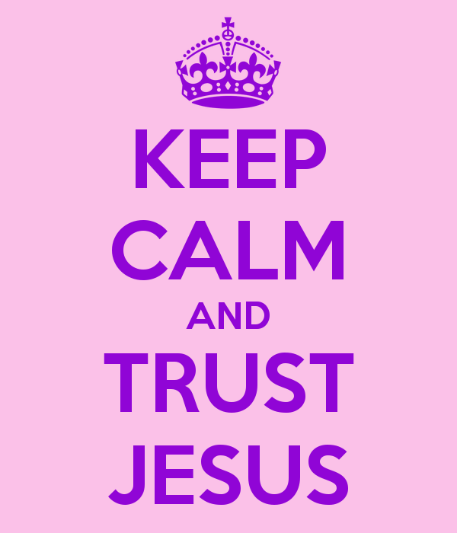
The State of Play: Summary

Slide 8
Creating a Training Culture Six Steps that might help.
Notes:
I don’t know who you are today.
You may be the Senior Minister of a Church, you may be a committed member, you may be here because

Slide 9
1.0 Set clear Ideals – (conviction):
1.1 Bible goals for people
Matthew 28:16-20
Moving people right
DMD
“Christ Learner” - TVP
1 Cor 4:14-17
“Way of life” in Christ

Slide 10
1.0 Set clear Ideals – (conviction):
Diagrammatically: page 85 “The Trellis and the Vine”
Notes:
The goal is to become a disciple making disciple.
In churches and ministries, we too easily opt for sub standard “ideals”.
Let me give you three examples:
We talk about “all member ministry” rather than “all member missionaries”
If John regularly attends church and John regularly does jobs on the roster like tea and coffee and counting the money; then John is doing ministry, in the sense that ministry is “service”. But he is not doing “word ministry” is not being a missionary.
We accidentally infer that “disciple making” is in actual fact “discipling”
The minister is “trainer not practitioner”. Jeffrey Vanderstelt of Soma Ministries in Tecoma, Washington State says, if a Pastor is not doing the work of an evangelist himself, 2 Timothy 4:5 then he may be disqualified from the ministry.

Slide 11
2.0 Audit your people :
Tool: page 87 of “The Trellis and the Vine”
Notes:
Auditing your people helps do the following:
Know how to pray wisely for people – we plant the seeds of the word, but it is God brings the growth
See who you can cluster together for training
See which areas of a whole ministry are weak (e.g. if there are very few in column #1 “Outreach” then there’s a fair chance your church has very little contact with outsiders. Churches that run ESL traditionally have lots of people in the two “Outrecah” columns titled, “Raising Issues” and “Gospel”.

Slide 12
3.0 Set up a clear training pipeline
Pipelines improve diagnosis
Pipelines = helpful referrals
Pipelines keep people Learning Christ

Slide 13
4.0 Do it Yourself – (competency):
Notes:
Now before I talk through the diagram.
Take 5 minutes to explain the diagram
I am not the Senior Minister (or even on staff) at Church.
In fact since April 2009, our church has had 3 different senior ministers (plus 1 temporary Locum).
The Tuesday Night Blokes “Community Group” tries to live by this and tries to make it work.
We’re not waiting for the heirarchy to set it up before we try to live it.
If you want to change the culture of your church – start by being a “Disciple Making Disciple” yourself.

Slide 14
5.0 Train others to do what you do – (multiply):
Invest deeply in a few
Give people a go!
“See one, do one, teach one”
How humans learn things:
70% - on the job
20% - by mentoring
10% - by formal training
“Don’t blame them, train them”.

Slide 15
6.0 You can’t manage what you don’t measure:
Notes:
When you measure things you can make informed decisions with regards allocating resources.
80% of Australians make a decisions for Jesus before the age of 20. Should 80% of a ministries resources be devoted to resources the minsitries aimed at under 20s??
Do we run a residential Church camp in 2017? Christian Venues Australia claims that those who attend residential weekend camps are twice as likely to be regular church attenders and are twice as likely to have a fervent spiritual life.

Slide 16
7.0 Continually Change Stuff:
Hardly anything stays the same “ambiguity tolerance” is needed
“10 in 2” helped me realise that there needs to be a three year cycle on outreach events (Public, group, personal)

Slide 17
Recommended Resources:
The Vine Project

Slide 18
Question Time

Slide 19
Creating a Training Culture Multiply Conference Ann St Presbyterian Church, Brisbane, QLD 17th May 2016.

